Slide 1
BUILDING A PREDICTION MODEL TO PREDICT DELAYS IN CONSTRUCTION LOGISTICS
KARTHIGA.S,
M.S (Software Engineering) ,
Reg.No:12MSE0227

Slide 2
1.Introduction
Productivity is a very important element in the process of construction project management especially with regard to the estimation of the duration of the construction activities, this study aims at developing construction productivity estimating model for marble finishing works of floors using Multivariable Linear Regression technique (MLR).
Ten influencing factors are utilized for productivity forecasting by MLR model, and they include age, experience, number of the assist labor, height of the floor, size of the marbles tiles, security conditions, health status for the work team, weather conditions, site condition, and availability of construction materials.
It was found that MLR have the ability to predict the productivity for finishing works with excellent degree of accuracy of the coefficient of correlation (R) 90.6%, and average accuracy percentage of 96.3%.

Slide 3
1.1 Multivariable Linear Regression
Productivity rates of construction trades are the basis for accurately estimating time and costs required to complete a project. Productivity could be defined as “the ratio of output of required quality to the inputs” for a specific production situation; in the construction industry, it is generally accepted as “work.
Productivity measurement provides the necessary data to analyze factors for project owners, constructors, and management professionals to control construction progress, estimate the cost of future construction projects, and determine its competitiveness in the global market. output per man-hours worked”.

Slide 4
2.Literature Survey
1) This study aimed at activity estimating model for marble finishing works of floors using multiple regression techniques. The model was developed based on 100 set of data collected in Iraq. Such types of models are very useful, especially in its simplicity and ability to be handled by calculator or a simple computer program.
2) Multivariable Linear Regression is used to examine several variables at once and the interrelationships between them. And MLR has the ability to predict the productivity of marble finishing works for floors with high degree of accuracy with 96.3% and the coefficients of determination R2 for the developed models equal to 0.8213. This indicates that the relationship between the independent variables of the developed models is good and the predicted values from a forecast model fit with the real-life data.
3) In this research, ten influential variables developing construction productivity estimating model. Size marbles have most significant effect on the productivity of marble finishing works for floors equal to 46.901 as an unstandardized coefficients. While the other input variables have moderate impact on the productivity such as health status of work team.

Slide 5
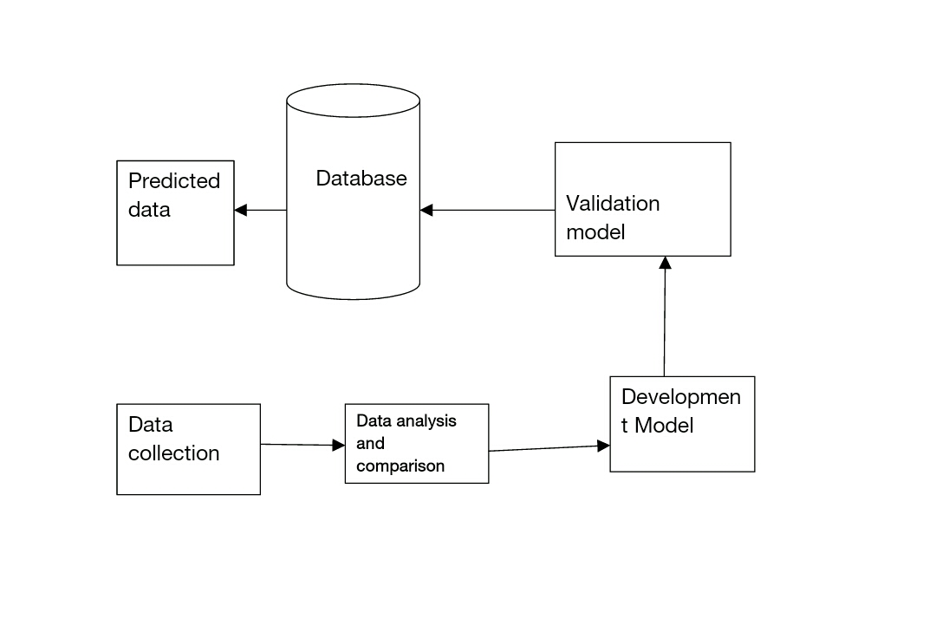
3.ARCHITECTURE

Slide 6
4. MODULES AND METHODS
1)Literature Review:
The review synthesized the findings from previous literature in textbooks, journal papers, research reports, conference proceedings, theses, dissertations, and Internet publications, and methods of productivity data analyses.
2) Data collection:
The researcher conducted on-site construction productivity measurements in the Iraq. The data were collected from observation and recompiled to a spreadsheet format that is suitable for statistical data analysis by using computer software, such as Statistical Package for the Social Sciences (SPSS).
3) Data analysis and comparison:
The data analysis were conducted by using the statistical software package, SPSS 19.0, for determining the productivity rate characteristics, and labor productivity .

Slide 7
4) Developed model: Based on the data analyses results, it will provide Multiple Linear Regression model to predicting productivity of marble finishing works for floors and discuses the results from training and testing this model;
5) Validation model: This stage, which presents the validation of the MLR model;

Slide 8
5.References
[2] D. Arditi, O. B. Tokdemir and K. Suh, “Effect of ing-of-Balance Scheduling,” International Journal of Pro- Learnject Management, Vol. 19, No. 5, 2008, pp. 265-277. doi:10.1016/S0263-7863(99)00079-4
[3] D. G. Proverbs, G. D. Holt and P. O. Olomolaiye, “A Comparative Evaluation of Planning Engineers’ Formwork Productivity Rates in European Construction,” Building and Environment, Vol. 33, No. 4, 2001, pp. 181-187. doi:10.1016/S0360-1323(97)00035-8
[4] J. Christian and D. Hachey, “Effects of Delay Times on Production Rates in Construction,” Journal of Construction Engineering and Management, Vol. 121, No. 1, 1995, pp. 20-26. doi:10.1061/(ASCE)0733-9364(1995)121:1(20)
[5] A. Kazaz and S. Ulubeyli, “A Different Approach struction Labour in Turkey: Comparative Pro Toconductivity Analysis,” Building and Environment, Vol. 39, No. 1, 2004, pp. 93-100. doi:10.1016/j.buildenv.2003.08.004
[6] C. H. Oglesby, H. W. Parker and G. A. Howell, “Productivity Improvement in Construction,” McGraw-Hill Book th Neural Networks,” Journal of Co., New York, 2000.

